Slide 1
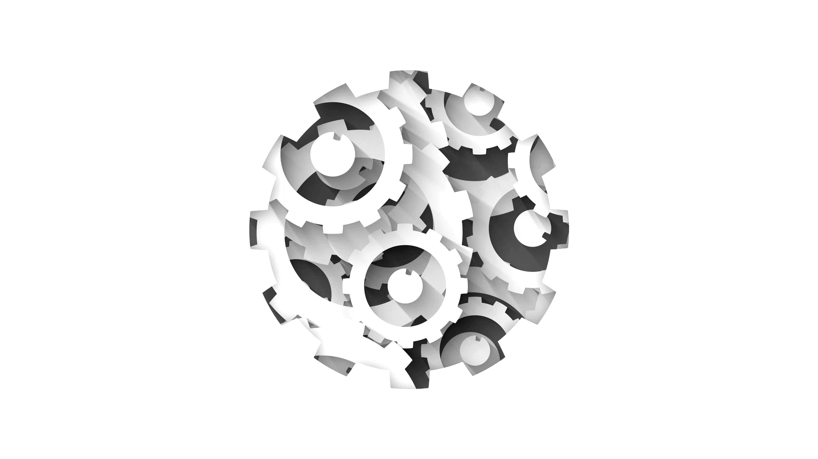


Software Engineering CS411, FALL 2025
Lecture 5: Domain Modeling by Dr. Mohamad Kassab
Leonidas Kontothanassis kthanasi@bu.edu

Slide 2

Lesson plan
How to Construct Domain Model from Use Cases.
Identifying Domain Classes
Identifying Attributes
Identifying Associations
Generalizations
Association Classes
Composition / Aggregation

Slide 3
What is a Domain Model?
The domain model captures the most important types of objects in the context of the system.
Domain objects represent the “things” that exist or events that transpire in the environment in which the system works.
The domain model is bounded by the use case scenario under development. It is not a description of software objects.
The domain model is a visualization of the concepts.
It comes from a specification of conceptual classes, their attributes and associations described via UML Class diagrams. Some domain models also include constraints.

Slide 4
Hoes does a Domain Model Looks Like?
Records-sale-of
Described-by
1
Product
Product
Catalog
Contains
Specification
1
1..
*
description
price
1
UPC
Association
0..1
*
Used-by
Describes
Sales
*
*
LineItem
Store
Stocks
Item
quantity
1
address
1
*
1
1..
*
name
Concepts
Contained-in
Logs-
1
Houses
1
completed
1..
*
6
Sale
*
register
date
Started-by
Manager
Captured-on
1
1
time
1
Paid-by
1
1
Initiated-by
1
3
Records-sales-on
Attributes
1
1
1
Payment
Customer
Cashier
amount

Slide 5
What is a Domain Model?
The domain model illustrates the domain classes and how they are related to one another by association.
It is a static model; therefore, no sequence of events or information flow is shown in the domain model.

Slide 6
How to Construct a Domain Model?
1- We must identify classes
2- We must identify Attributes
3- We must identify Associations
Notes:
The domain model is optional (AKA Conceptual model)– Its bounded by the use case scenario under development for the current iteration
The domain model can in turn influence operation contracts, a glossary and the design model.
Its not a description of software objects, it is a visualization of the concepts or mental models of a real-world domain.
To create a domain model
Find the conceptual classes
Draw them as classes in a UML class diagram
Add association and attributes

Slide 7
Identifying Classes
The textual description of the use case; create a list of potential classes.
Use the nouns to identify potential classes or attributes.
Notes:
References to one another help to identify associations
Concept category: list of candidate conceptual classes

Slide 8
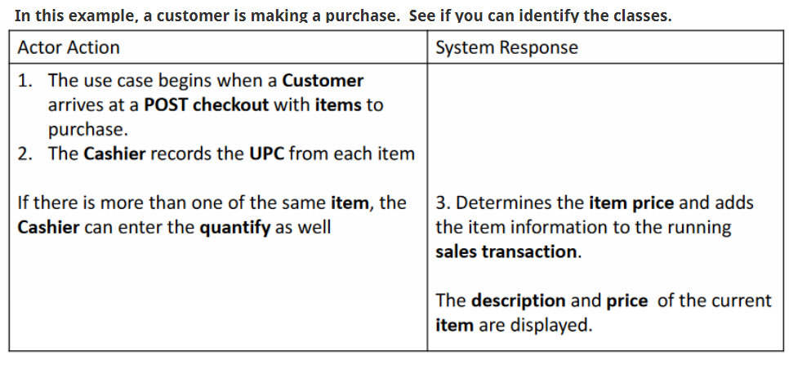
Identifying Classes

Slide 9
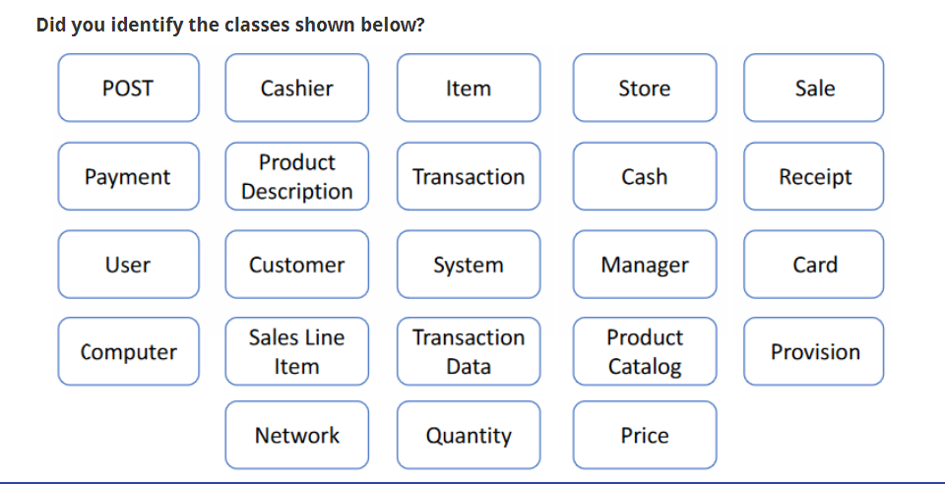
Concepts coming from a collection of use cases listed below
Notes:
This is a collection from many cases not just the one shown earlier

Slide 10
Pruning the List of Classes
Examine list of potential classes & eliminate
Redundant Classes: Two classes that express the same information
Irrelevant Classes: Classes that have little or nothing to do with the problem
Vague Classes: Classes with ill-defined boundaries or too broad in scope
Implementation Specific Classes: Classes that represent software or processes

Slide 11
Example: Pruning the List
system
Quantity
cash
transaction
data
network
Price
irrelevant
attribute
central
computer
implementation
record keeping
provision
redundant
vague
Bad classes
Good classes
register
Item
Customer
Store
Sale
Sales
Line Item
Cashier
Manager
Payment
Product
Catalog
Product
Specification
Notes:
This is a partial example and does not include every class that is listed on slide 9. Left as exercise to the reader to figure out where the missing ones belong.

Slide 12
Taking this example further, the “good classes” were put into a domain model diagram. This diagram shows the multiplicity which defines how many instances of class A can be associated with class B. For example, a single instance of Store can be associated with “many” (zero or more, indicated by the *) Sale instances.
Records-sale-of
Described-by
1
Product
Product
Specification
Catalog
Contains
1
1..
*
description
price
1
UPC
0..1
*
Used-by
Describes
Sales
*
*
LineItem
Store
Item
Stocks
quantity
1
address
1
*
1
*
name
1..
Contained-in
Logs-
1
Houses
completed
*
1
6
1..
Sale
*
register
Started-by
Manager
date
1
1
Captured-on
time
*
1
1
1
Initiated-by
1
Paid-by
3
Records-sales-on
1
1
1
Payment
Customer
Cashier
amount
Notes:
Multiplicity – defines how many instances of class A can be associated with class B
Single instance of store can be associated with “many” (zero or more, indicated by the *) Sale instance

Slide 13
How to Construct a Domain Model?
1- We must identify classes
2- We must identify Attributes
3- We must identify Associations
Notes:
The domain model is optional (AKA Conceptual model)– Its bounded by the use case scenario under development for the current iteration
The domain model can in turn influence operation contracts, a glossary and the design model.
Its not a description of software objects, it is a visualization of the concepts or mental models of a real-world domain.
To create a domain model
Find the conceptual classes
Draw them as classes in a UML class diagram
Add association and attributes

Slide 14
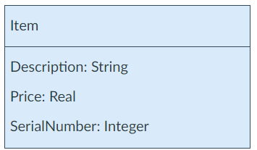
What is a Class Attribute?
After deciding on the list of domain classes to include, we need to add the essential attributes to each class.
A class encapsulates the state (attributes) of an object. These are the logical data values of the objects.
Attributes should be included when requirements suggest or imply a need to remember information.

Slide 15
Attributes
Include attributes when requirements suggest or imply a need to remember information
The syntax of an attribute is
[visibility] name [multiplicity] [:type] [= initial value] [{property}]

Slide 16
Attributes (Contd.)
Examples:
height Name only
+ height Visibility and name (public)
height : Integer Name and type
name [0..1]: String Name, multiplicity, and type
width : Real = 0.0 Name, type, and initial value
id: Integer {frozen} Name, type, and property
Notes:
Property described on next slide

Slide 17
Attributes (Contd.)
A property of an attribute can be:
Changeable No restrictions on modifying the attribute's value.
addOnly For attributes with a multiplicity greater than one,
additional values may be added, but once created,
a value may not be removed or altered.
frozen The attribute’s value may not be changed after the
object is initialized.

Slide 18
Attributes (Cont.)
Attributes should preferably be simple attributes or data types.
In the domain mode, attributes should be data types generally where the types are very common: Boolean, Date, Number, String/text, time.
Other common types are: Address, color, phone number, SS#, UPC, SKU, ZIP, enumerated types.
Tip 1: Stick to simple types.
Tip 2: If in doubt, define something as a concept, rather than an attribute.

Slide 19
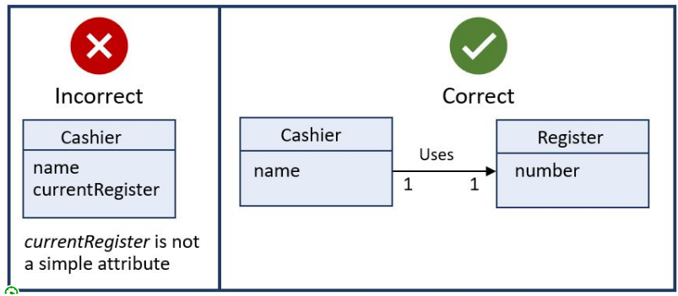
Example 1:
Register is a complex concept, not a simple one. If you want to relate the Cashier to Register, it is advisable to relate the two concepts through an association rather than having Register an attribute in the class Cashier.

Slide 20
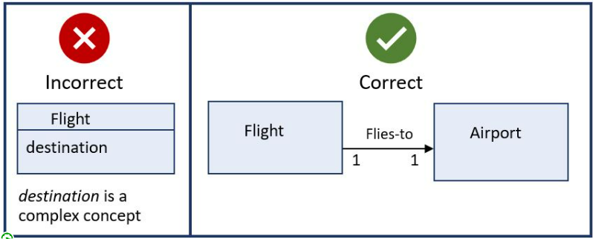
Example 2:
Here is another example of wrongly representing complex domain concepts as attributes. Again, you want to use associations.
In this example, the airport "destination" is not just a string. It is much more complex, therefore a flight should be related to the airport via an association.

Slide 21
Attributes vs. Concepts
Does it make sense to distinguish between two separate instances of a Person whose names are John Doe?
In attributes, identity is determined by the value
Tip:
Stick to simple types
If in doubt, define something as concept, rather than attribute
Notes:
Yes it is meaningful to distinguish between two separate person instances whose names are both John Doe
The subtlety here is that if Name becomes a concept you can be more flexible. A person can use multiple names. The same name can be used by multiple persons etc.

Slide 22
How to Construct a Domain Model?
1- We must identify classes
2- We must identify Attributes
3- We must identify Associations
Notes:
The domain model is optional (AKA Conceptual model)– Its bounded by the use case scenario under development for the current iteration
The domain model can in turn influence operation contracts, a glossary and the design model.
Its not a description of software objects, it is a visualization of the concepts or mental models of a real-world domain.
To create a domain model
Find the conceptual classes
Draw them as classes in a UML class diagram
Add association and attributes

Slide 23
Association
An association is a relationship between concepts that indicates some meaningful and interesting connection
Records-current
Register
Sale
1
*

Slide 24
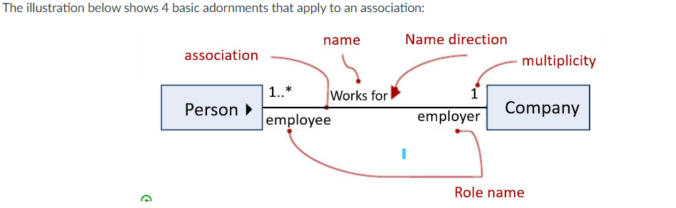
Associations
One Person participating in this relationship works for ONE Company
One Company in this relationship may have "ONE or MORE" Persons working for it.
Notes:
All of those can be omitted if they can easily be inferred but if in doubt list them explicitly.

Slide 25
Association Adornments
There are 3 basic adornments that apply to an association:
name - describes the nature of the relationship. To avoid ambiguity about its meaning, the direction of the association can be shown with a triangle.
role - when a class participates in an association, it has a specific role that it plays in that relationship: a role can be thought as the face the class at the near end presents to the class at the other end.
multiplicity – cardinality of the relationship. Indicates how many instances of the classes participate in the given relationship.
Notes:
The accessories of associations
Roles are important when a concept can interact with another concept but they can do so in multiple way or different ways for different concepts.
Think employees. One can be a manager and the other a subordinate. If you have employee manages employee it could be confusing.

Slide 26
How to Identify an Association?
Examine the concepts for the following relationships:
A is physical or logical part of B
A is physically or logically contained in/on B
A is recorded in B

Slide 27
Association Guidelines
Focus on “need-to-know” associations
High priority associations are strongly “need-to-know”
It is more important to identify concepts than associations
Showing too many associations at this phase can confuse a domain model

Slide 28
Special Considerations for Associations
Generalizations
Association Classes
Aggregation and Composition

Slide 29
Generalization
One type of association is Generalization. This type aims to organize concepts to identify commonality among them.)
The superclass of payment and the subclasses of cash payment, credit payment, check payment
Payment
This is how we represent Generalization in UML
Cash Payment
Credit Payment
Check Payment

Slide 30
Generalization (Contd.)
Generalization creates a conceptual class hierarchy when
Subclasses have additional attributes of interest
Subclasses have additional associations of interest
The subclass concept is manipulated differently than the superclass and other subclasses

Slide 31
Subclass Definition: 100% Rule
100% of superclass’ definition should be applicable to subclass
This includes:
Attributes, and
Association
Example:
Payment has an amount and pays for a sale
This is true for CreditPayment, CashPayment, CheckPayment
Notes:
Example is shown on slide 43

Slide 32
When to define subclass
Subclass has additional attributes of interest
Library: Book, a subclass of Loanable resource, has ISBN attribute
Subclass has additional associations of interest
Register: CreditPayment, a subclass of Payment, is associated with a CreditCard
Subclass is operated, handled or acted differently than superclass
Register: CreditPayment, a subclass of Payment, is handled differently than other kinds of payments
Subclass behaves differently than superclass
Market Research: Child, subclass of Human, behaves differently than Parents with respect to sleep habits

Slide 33
Abstract Conceptual Classes
If every member of a superclass must also be a member of a subclass then that superclass is an abstract superclass
An abstract class cannot be instantiated
Payment class in our previous example is an abstract class
In UML, the name of an abstract class is italicized

Slide 34
Modeling Changing States
Do not model states of a concept as subclass of X. Rather:
Define a state hierarchy and associate the states with X, or
Ignore showing states of a concept in the conceptual model; show them in state diagrams
Notes:
Example shown in Diagram next slide

Slide 35
Example: Payment States
This is a better way to represent states in a domain model. Or ignore showing the states in the domain model.
Avoid This Situation
Payment
Payment
Is-in
Payment
State
*
1
Authorized
Payment
Unauthorized
Payment
Authorized
State
Unauthorized
State
Notes:
Diagram on right is better.
Payment can be authorized or unauthorized – however, payment doesn’t stay in one of these states – it is a transition from unauthorized to authorized – rules apply on previous slide.

Slide 36
Association Classes
Let's consider an example using a "Person" and "Company" scenario”.
Assume you have a system where individuals can be employed by multiple companies, and for each employment, there is additional information such as the role or position and the start date.
In this case, you can use an association class to represent the relationship between "Person" and "Company" with the added information about the employment.
Employs 0..* *
Person
Company
Employment
Notes:
We can see from the diagram that a Person may work for a single Company. We need to keep information about the period of time that each employee works for each Company.
We can do this by adding a dateRange attribute to the association. We could add this attribute to the Person class, but it is really a fact about a Person's relationship to a Company, which will change should the person's employer change.

Slide 37
Association Classes (Contd.)
Create an association class if
An attribute is related to an association.
Instances of the association class have a life-time dependency on the association.
There is a many-to-many association between two concepts, and information associated with the association itself
Notes:
Example of first one on previous slide

Slide 38
Associative Classes: Examples
Employs
Company
Person
Student
Enrolls-in
*
*
Course
Employment
salary hireData
Enrolment
grade

Slide 39
Aggregation
It is a kind of association used for modeling whole-part relationships
Shown in UML as a hollow diamond symbol at the “whole end” of the whole-part association
No semantic difference to a regular association, which is why Larman avoids it.

Slide 40
Composition
It is a specialized form of aggregation
Shown in UML as a filled diamond symbol at the “whole end” of the whole-part association
More meaningful than aggregation.
The parts are “owned” by the whole…they are often created together, they definitely die together, and operations applied to the whole propagate to the parts.

Slide 41
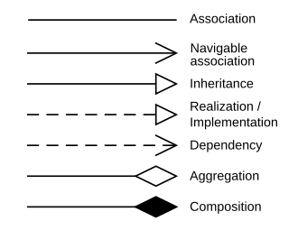
UML Symbols (subset)
Generalization (Inheritance). Arrows points to parent
Composition. Part of a whole entity. Only exists if the whole exists. Folder/File.
Aggregation. Part of a whole entity. Can exist if the whole goes away. Team/Player.

Slide 42

Recommended Exercise
Create a UML domain model for the Library System Use Case (available in Supplementary Reading: EXAMPLE-LIBRARY.pdf)

Slide 43
Library Use Case
Use Case: Borrow Library Resources
Actor Actions
1. Patron arrives at a checkout with library resources (e.g. books, videos, tapes,…) to borrow. Some of the resources can be borrowed for free, while others will have a borrowing fee.
2. The library patron presents their membership identification to the library staff, who enters it into the system.
4. For each library resource, the library staff records the item identification into the system.
6. Library staff informs library patrons of total borrowing fee, and asks for payment.
7. Library patron pays cash to library staff.
8. Library staff records payment into system.
10. Library staff gives receipt and loan report to library patron, who then leaves with the rental resources.
System Response
3. Presents membership information, and status of loans (usually nothing on loan, and no outstanding fines).
5. Presents accumulating list of resources titles, due dates. The standard due date is 3 weeks from today.
9. Generates receipt and loan report.

Slide 44
Possible Concepts
Patron, checkout, library, resources (books, videos, tapes), borrowing fee, membership, library staff, system, loan, resource titles, due dates, borrowing free, payment, cash, receipt, loan report.

Slide 45


Readings , Assignments, Project Tasks
Read:
Chapters 6, 7 of the textbook.
Assignments & Project Tasks:
Assignment 1 is open (Due on Friday). This is an Individual Submission.

Slide 46
Poll
https://piazza.com/class/mcf8iluri7n5wk/post/62

Slide 47

Questions?

